Slide 1

Practical Classes
Chris Piech
CS106A, Stanford University

Slide 2

Learning Goals
Be able to create a variable type from scratch

Slide 3
A class defines a new variable type

Slide 4
You must define three things
1. What variables does each instance store?
2. What methods can you call on an instance?
3. What happens when you make a new one?
*details on how to define these three things coming soon

Slide 5
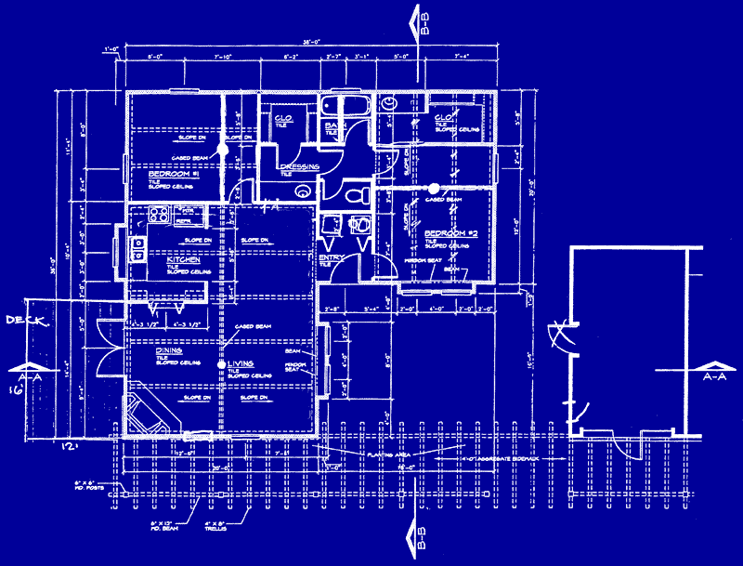

Classes are like blueprints
class: A template for a new type of variable.

Slide 6
What does a class do?

Slide 7
A class defines a new variable type

Slide 8
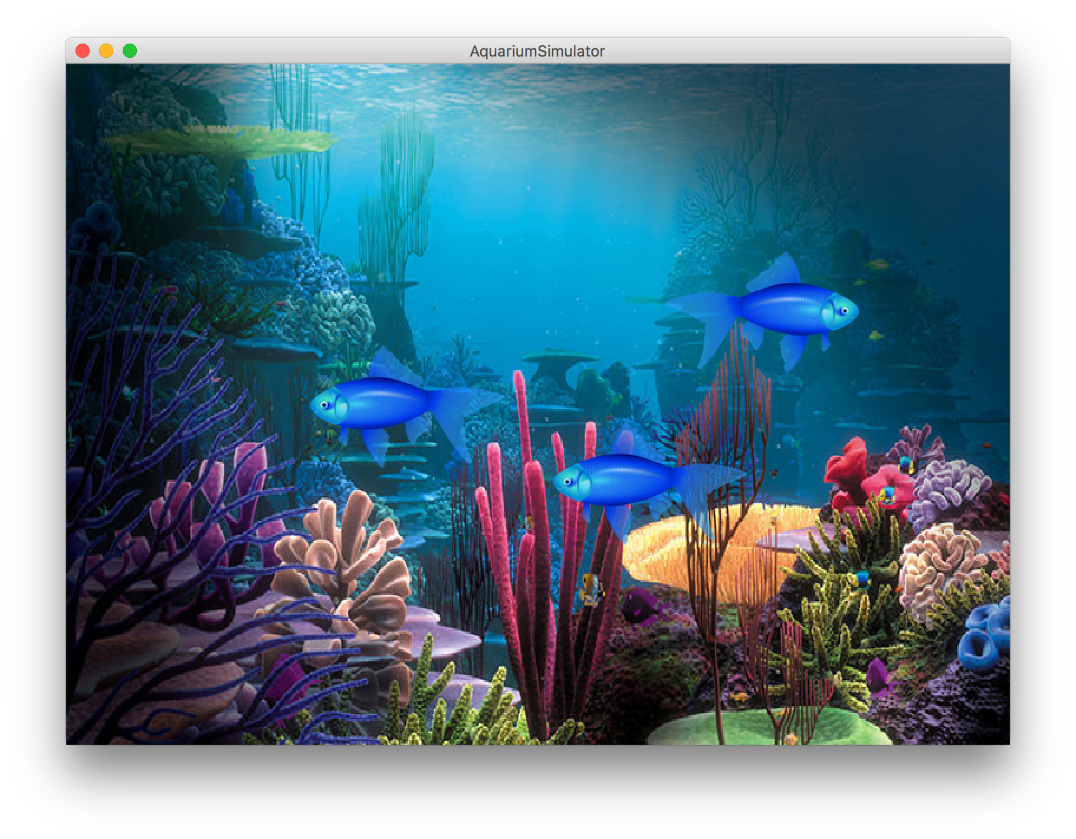
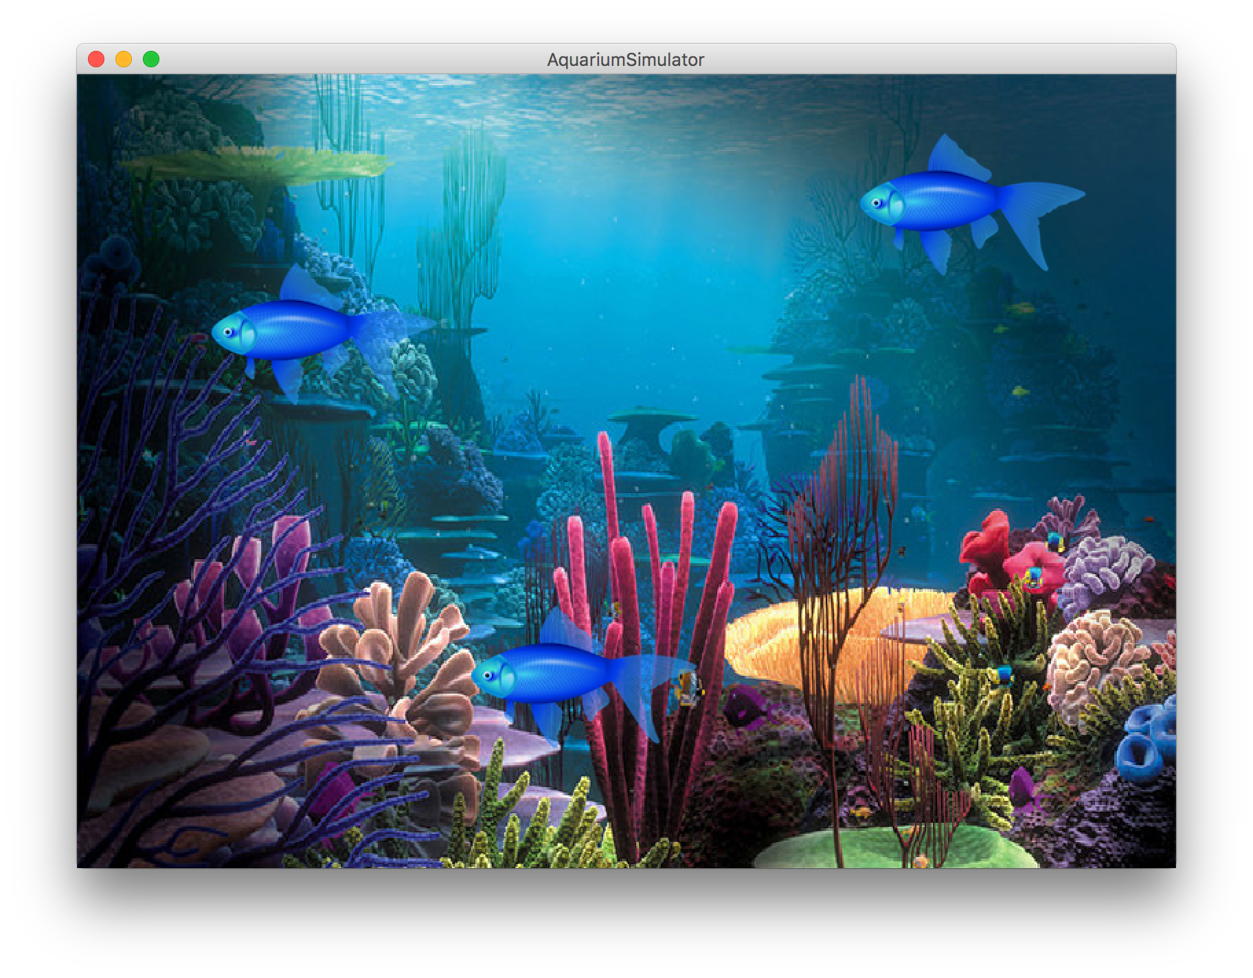

Slide 9
extends
Make a class inherit all the
instance variables and methods
of another class

Slide 10
public class Simulator extends GraphicsProgram {
// class definition
}

Slide 11
public class NameSurferGraph extends GCanvas {
// class definition
}

Slide 12
implements
I promise that this class will define
a few given methods

Slide 13
public class NameSurferGraph extends GCanvas,
implements ComponentListener {
// class definition
}

Slide 14
Also a cheeky way to share constants between classes
implements
I promise that this class will define
a few given methods

